Slide 1
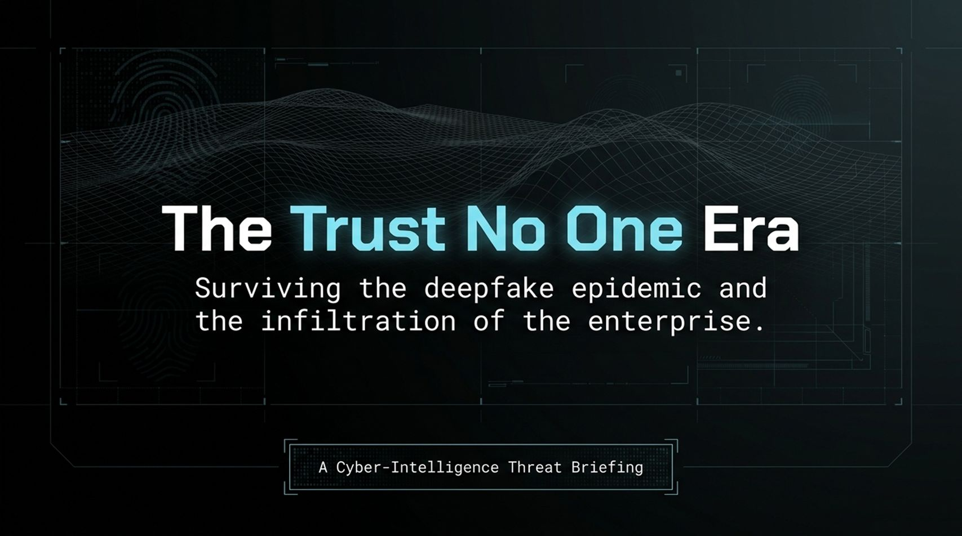
Notes:
Opening & Context: Welcome everyone. Today, we are discussing a critical shift in the digital landscape—what cyber-intelligence experts describe as the transition into the "Trust No One Era." For decades, organizations operated under the assumption that seeing or hearing someone digitally was a reliable form of authentication. That era is officially over.
The Core Issue: We have entered a paradigm where generative AI has democratized deception at scale. Synthetic media, real-time face swaps, and voice cloning have progressed from novelty novelties to active, highly efficient enterprise threat vectors.
Key Takeaway: As we walk through this briefing, the core theme to keep in mind is this: Digital trust can no longer be assumed; it must be architected. We are going to explore how this threat evolved, where traditional defenses fail, and how C-suite leadership must adapt.
https://www.youtube.com/watch?v=0GcO9TIrHYw

Slide 2
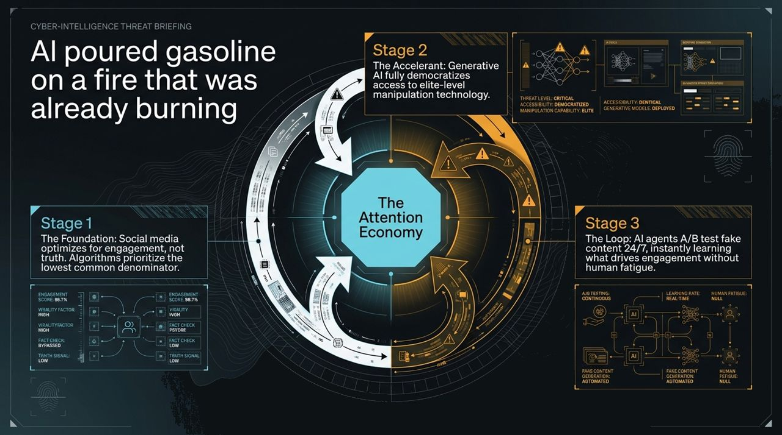
Notes:
Stage 1 (The Foundation): It is important to emphasize that AI didn't create the truth problem online—it accelerated it. The foundation was built by social media platforms optimizing purely for engagement over truth. Algorithms were engineered to prioritize content that sparks high emotional outrage, tapping into the lowest common denominator of human behavior.
Stage 2 (The Accelerant): Generative AI acted as the accelerant. Previously, high-end media manipulation required state-level resources or specialized visual effects teams. Generative models fully democratized access, putting elite-level manipulation technology in the hands of any actor with a laptop.
Stage 3 (The Loop): The most dangerous component today is automated agent loops. AI agents can now deploy, continuous A/B test fake content 24/7 without human fatigue. They instantly learn which synthetic variants drive engagement and bypass automated filters.

Slide 3
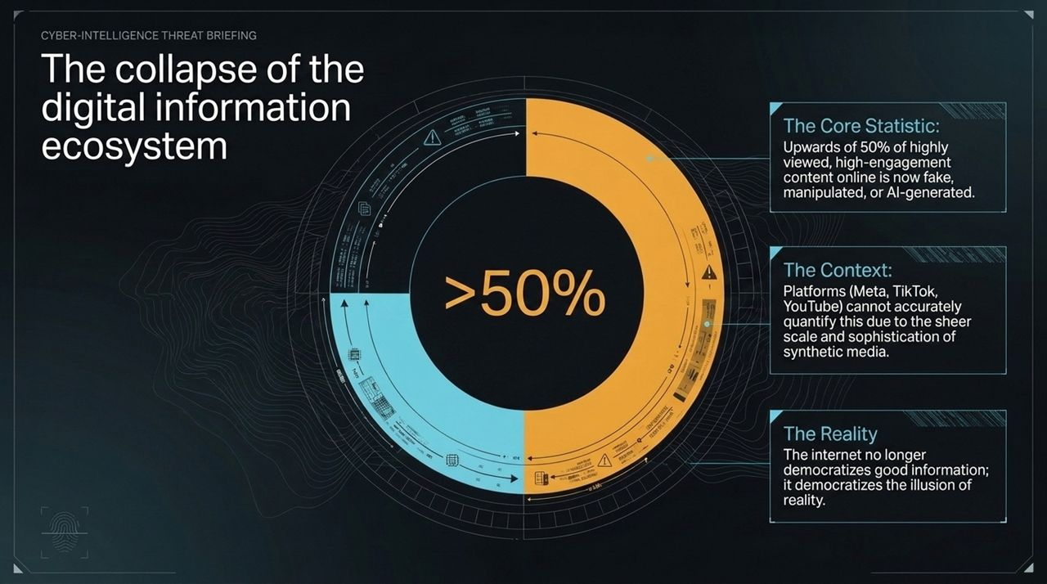
Notes:
The Core Statistic: If you examine the content driving high engagement online—the media receiving millions of views—upwards of 50% is now fake, manipulated, or synthetically generated.
The Platform blindspot: Platforms like Meta, TikTok, and YouTube cannot accurately quantify or control this due to the sheer volume and speed of synthetic media production. While platforms periodically take down hundreds of thousands of "AI slop" channels, it is a game of scale they are currently losing.
The Paradigm Shift: The internet’s original promise was the democratization of good information. The reality today is that it has democratized the illusion of reality. When individuals consume information via unvetted social feeds, they are effectively entering customized, synthetic echo chambers.

Slide 4
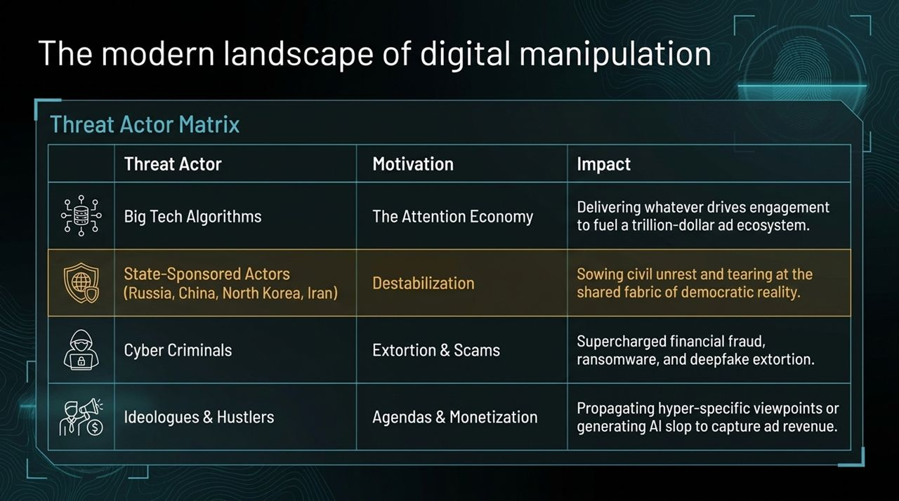
Notes:
Navigating the Threat Matrix: To defend our organizations, we must map who is manipulating information and why.
Big Tech Algorithms: Their primary driver is ad revenue within the trillion-dollar attention economy. The impact is algorithmic friction that feeds users whatever content keeps them scrolling, completely indifferent to accuracy.
State-Sponsored Actors (Russia, China, North Korea, Iran): Their motivation is geopolitical destabilization. They deploy coordinated deepfakes and botnets to sow civil unrest, erode trust in democratic systems, and weaken adversary resilience.
Cyber Criminals: Motivated purely by extortion and monetary gain. They use deepfakes for CEO fraud, voice-cloned wire transfer authorizations, and ransomware/extortion schemes.
Ideologues & Monetizers: Ranging from bad-faith actors pushing specific agendas to individuals deploying "AI slop" channels purely to siphon programmatic ad revenue.

Slide 5
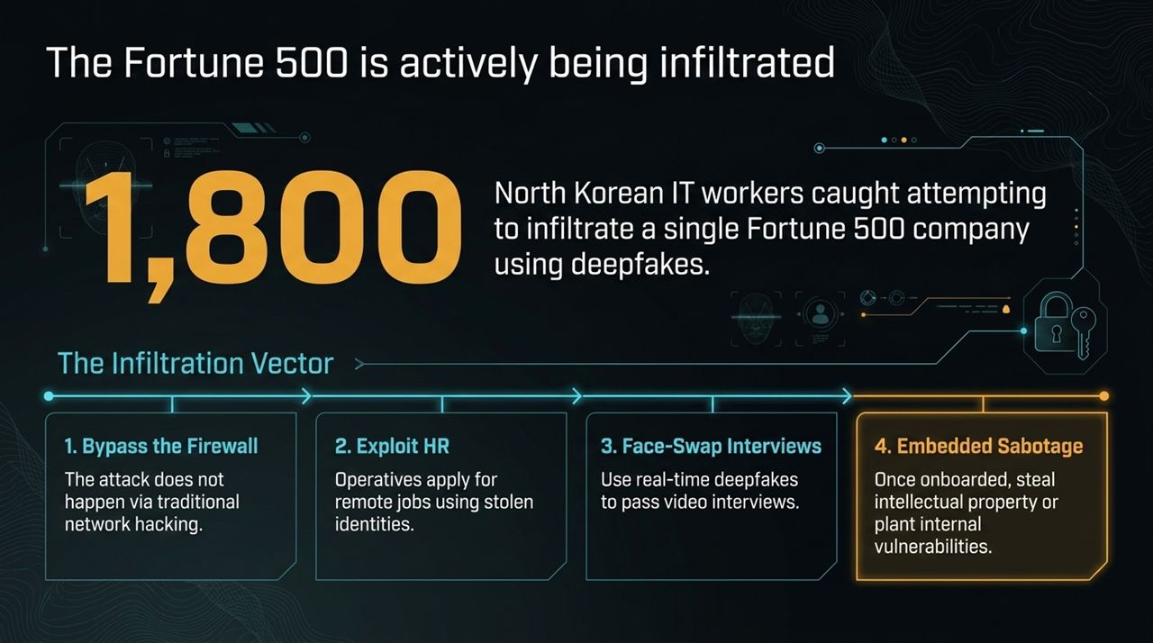
Notes:
The Vector Shift: Threat actors are no longer relying solely on hacking through traditional network firewalls. They are infiltrating organizations through Human Resources and remote onboarding processes.
Real-World Case Study: Dr. Hany Farid highlights a case involving one of the world's largest employers that detected and caught 1,800 potential North Korean IT operatives attempting to infiltrate their organization using stolen identities and deepfakes. Another U.S. defense contractor discovered five active North Korean operatives embedded within their systems.
The Four-Step Infiltration:
Operatives apply for remote technical roles using stolen identities.
During video interviews, they use real-time face-swapping software or proxy interviewees to pass technical evaluations.
Once onboarded, a completely different individual assumes the position.
Embedded bad actors exfiltrate intellectual property, funnel salary funds to foreign regimes, or plant internal network vulnerabilities.

Slide 6
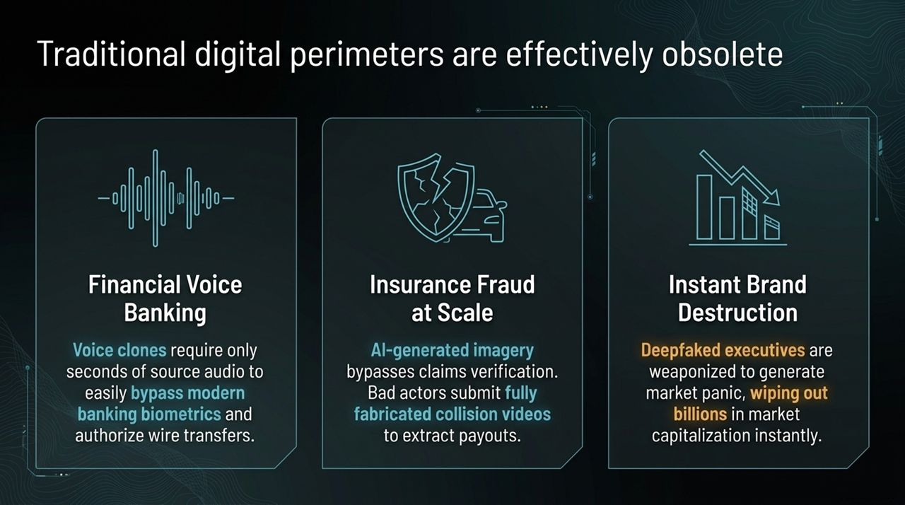
Notes:
Bypassing Biometrics: Traditional authentication models are failing. For example, voice biometrics like "my voice is my password" are compromised. Attackers require as little as 10 to 15 seconds of scraped audio to clone an executive or customer's voice and pass voice-verification checks.
Insurance Fraud at Scale: Visual verification systems are easily bypassed using synthetic media. Claimants submit fully AI-generated collision videos or damaged property imagery, successfully extracting payouts from automated claim systems.
Instant Brand Destruction: A fabricated video showing a CEO making illegal statements or announcing false financial distress can circulate online, wiping out billions in market capitalization before communications teams can issue a statement.

Slide 7
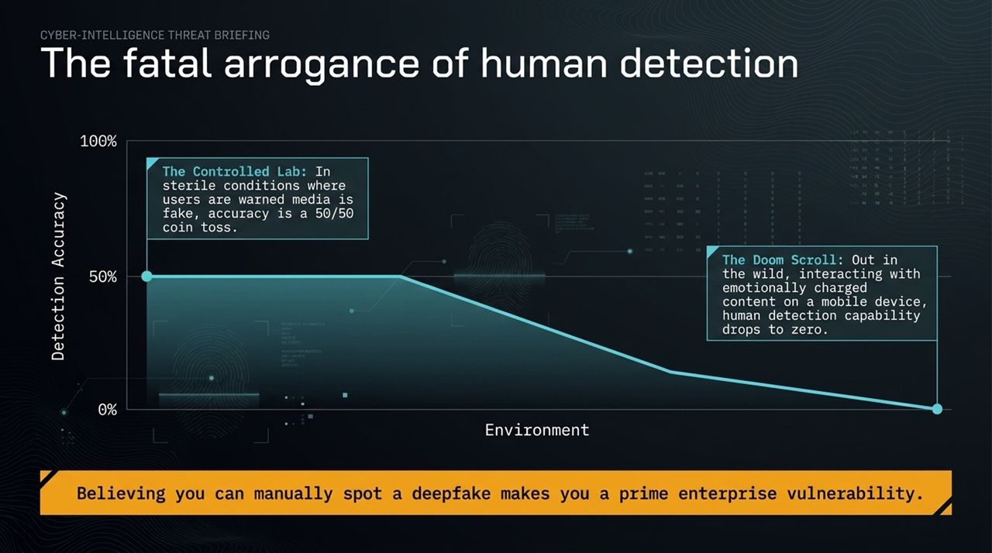
Notes:
The Detection Fallacy: A dangerous enterprise vulnerability is the belief that employees or executives can "spot" a deepfake using visual intuition.
Lab Data vs. Reality:
In Controlled Labs: When subjects are explicitly alerted that media may be fake and are placed in an unemotional testing environment, detection accuracy is barely above a 50/50 coin toss.
In the Wild ("The Doom Scroll"): On mobile devices, under time pressure, or during emotionally charged business interactions, human detection accuracy drops to zero.
The "Arrogance-Ignorance" Problem: Believing your visual or auditory systems are reliable defenses makes your personnel prime targets for social engineering.

Slide 8
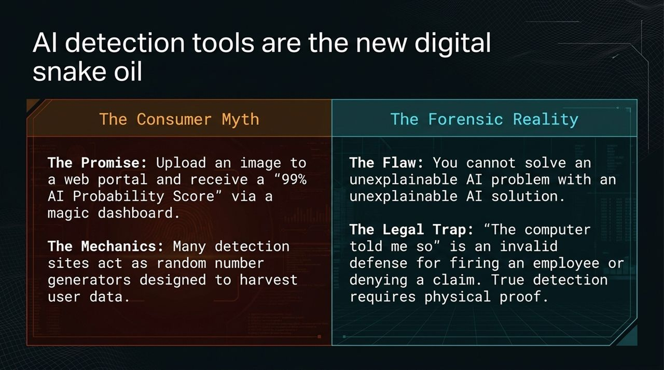
Notes:
The Consumer Myth: Many organizations attempt to solve the deepfake challenge by subscribing to web portals promising "99% AI Detection Accuracy." Dr. Farid's research indicates that many of these commercial web detectors act as little more than random number generators designed to harvest user data.
The Black-Box Problem: You cannot reliably solve an unexplainable AI problem with an unexplainable AI detection model. Black-box neural network detectors fail frequently and give no verifiable explanation of why media is flagged.
The Legal Trap: In corporate discipline or legal proceedings, stating "the computer detector told us it was fake" is legally unsupportable. True forensic verification requires explainable, physical proof.

Slide 9
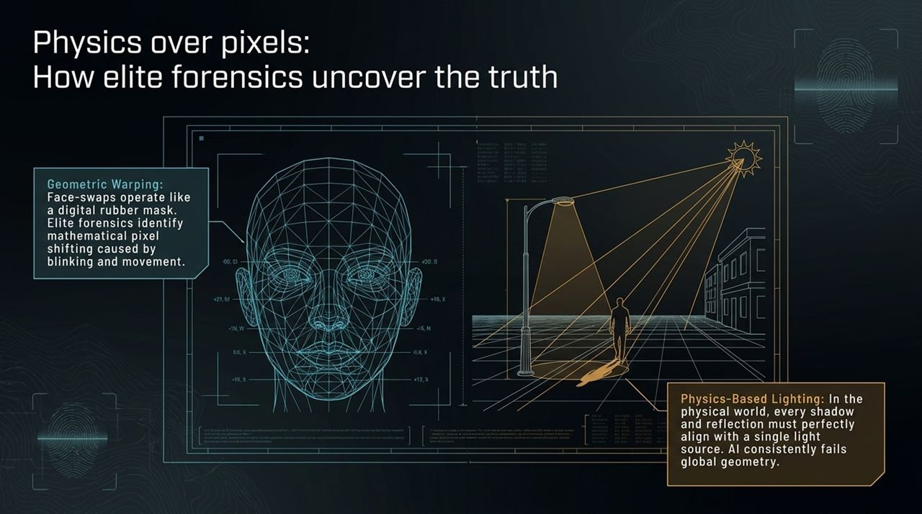
Notes:
Explainable Forensics: Rather than relying on black-box neural networks, elite forensic science relies on physical, geometric, and statistical proofs.
Geometric Warping: Real-time face swaps act like a digital mask conforming to a live target. Forensic tools measure pixel-level mathematical warping and boundary inconsistencies introduced around facial perimeters, eyes, and mouth movements.
Physics-Based Lighting: In physical space, light sources (such as the sun or office lighting) obey strict geometric properties. Forensics map shadows, surface reflections, and illumination vectors across a video frame. Generative models routinely fail to align light geometry across multiple physical objects in a scene.

Slide 10
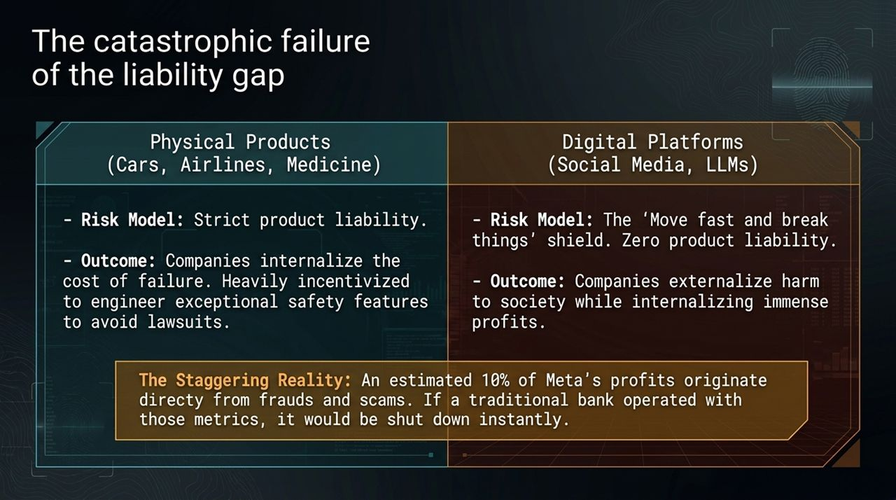
Notes:
Product Liability Discrepancy: In physical industries (automotive, pharmaceuticals, aviation), strict product liability forces manufacturers to internalize safety risks. If a car manufacturer releases an unsafe vehicle, legal liability incentivizes strict safety engineering.
The Digital Shield: Tech platforms have operated for 25 years under a liability shield ("move fast and break things"). They internalize vast profits while externalizing risks, harm, and fraud onto society and enterprises.
The Key Metric: An estimated 10% of Meta’s overall profits originate directly from ad revenue associated with frauds and scams. If a commercial bank operated under similar risk-to-profit metrics, regulatory authorities would shut it down immediately.

Slide 11
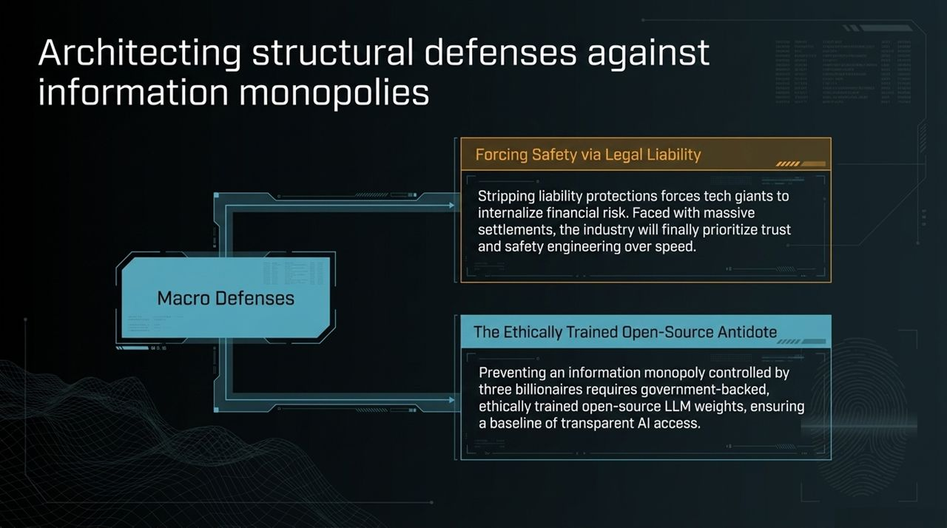
Notes:
Macro Defenses: Addressing this issue requires structural policy changes at the regulatory and industry levels.
1. Forcing Safety via Legal Liability: Stripping tech platforms of total liability protection forces tech companies to engineer safety directly into their products. Facing substantial legal settlements, companies will allocate capital toward trust and safety engineering.
2. Ethically Trained Open-Source Infrastructure: To prevent an information monopoly where a handful of executives control information flows, governments must back ethically trained, open-source LLM weights. Open base models provide transparent, accessible foundations for safe innovation.

Slide 12
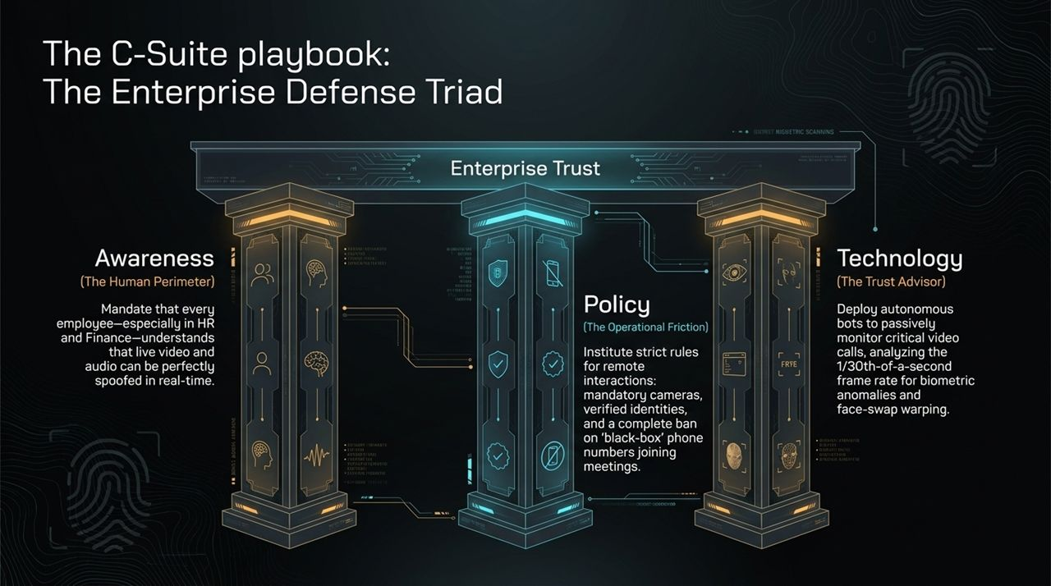
Notes:
Enterprise Defense Triad: For corporate leadership, defending the organization requires three synchronized pillars:
1. Awareness (Human Perimeter): Education must move beyond static phishing modules. Employees in HR, Procurement, and Finance must be trained on real-time video/audio deepfake capabilities.
2. Policy (Operational Friction): Reintroduce necessary friction into operations. Enforce strict video call protocols: mandatory cameras for interviewees, verified identities, and an absolute ban on unvetted, "black-box" phone numbers joining internal executive meetings.

Slide 13
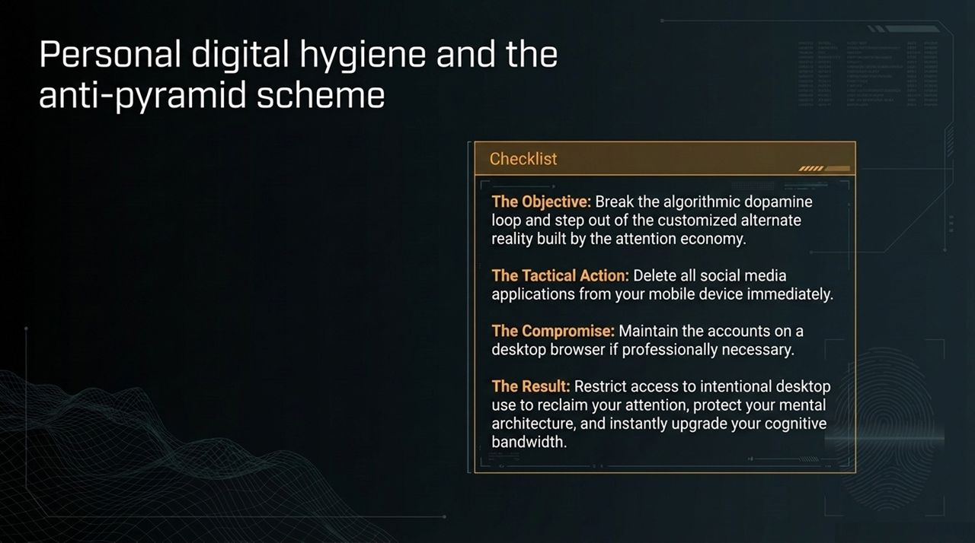
Notes:
Personal Defense: Beyond enterprise policy, executive leadership and employees must safeguard their individual cognitive bandwidth.
The Tactical Action: Delete social media applications directly from your mobile device.
The Compromise: If social media management is necessary for business, restrict access strictly to desktop web browsers.
The Outcome: Removing these applications from your phone breaks the algorithmic dopamine feedback loop. It prevents continuous exposure to customized synthetic media feeds and restores cognitive clarity.

Slide 14
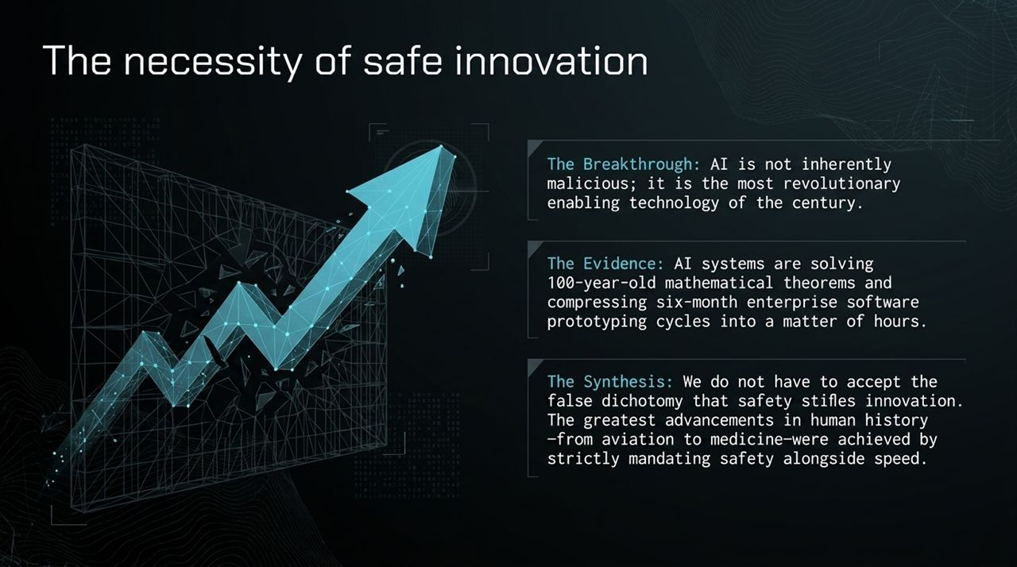
Notes:
Reframing the Narrative: Demanding digital safety is not anti-AI. AI is one of the most powerful enabling technologies of our era, solving complex mathematical theorems and compressing software prototyping cycles from months to hours.
Rejecting the False Dichotomy: Big Tech frequently argues that regulation or safety mandates will stifle innovation and hand advantages to foreign adversaries. We must reject this narrative.
Historical Precedent: The safest industries—commercial aviation, medicine, and automotive engineering—achieved massive advancements precisely because safety was strictly mandated alongside speed. Enterprise security and technological progress must coexist.

Slide 15
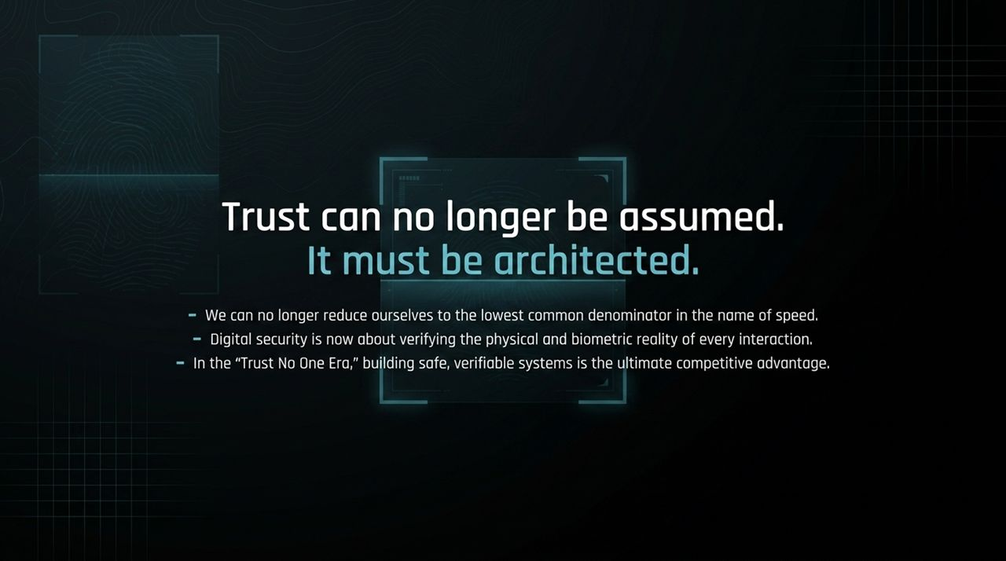
Notes:
Concluding Summary: To summarize our directive in this threat environment:
We can no longer lower operational security standards in the pursuit of pure speed or friction-free interactions.
Digital security now requires active verification of physical and biometric realities across all communication channels.
In the "Trust No One Era," organizations that architect verifiable, resilient trust structures will secure a distinct competitive advantage.

Slide 16
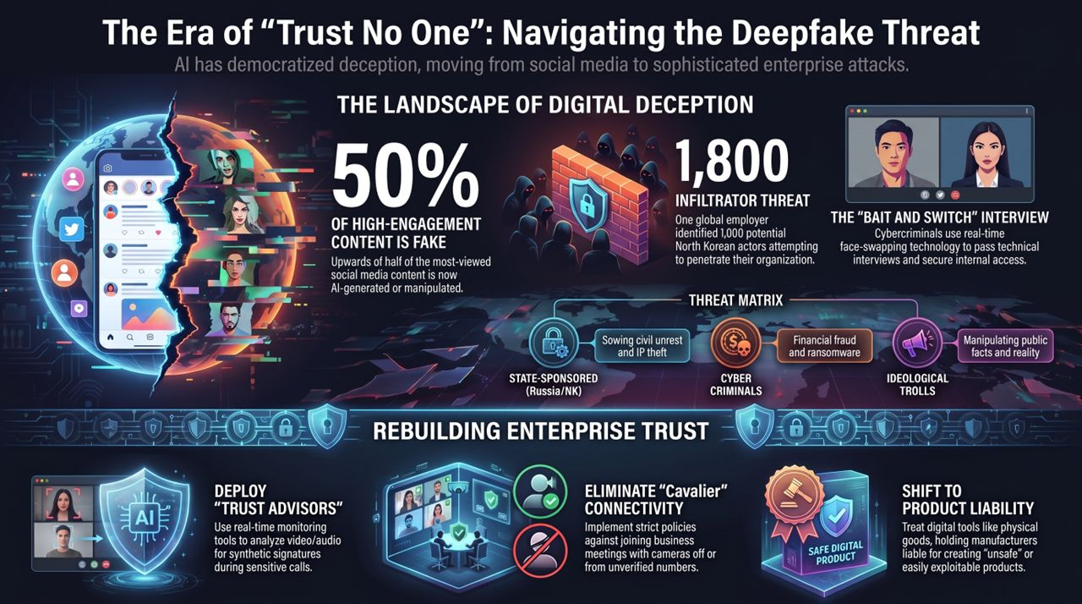
Notes:
Executive Recap: This final slide serves as an executive leave-behind summarizing the core briefing metrics:
Landscape: Upwards of 50% of high-engagement online content is synthetic or manipulated.
Enterprise Threat: Over 1,800 North Korean threat actors were identified targeting a single global enterprise via deepfake video interviews.
Action Matrix: Rebuilding enterprise trust requires:
Eliminating cavalier connectivity (enforcing camera usage, banning anonymous call-ins).
Deploying Trust Advisors for real-time biometric and frame-rate analysis.
Advocating for product liability to align digital technology standards with physical product safety.

